Slide 1
MULTILEVEL INVERTER BASED ON SWITCHED-CAPACITANCE STRUCTURE
Guided By,
Prof. Sanish Kumar T G
Department of EEE
GEC Thrissur
Presented By,
Alin Anto(16) S7 EEE A
Abhilash M M(2) S7 EEE A
Don Dev(44) S7 EEE A
Devika Sajeev(40) S7 EEE A

Slide 2
Contents
Introduction
Objective
Principle and Working
Stages of Work
Schedule
Current Progress
Expected Results

Slide 3
Introduction
Problems in multilevel inverters (MIs) employing current topologies used were identified:-
Large number of components( switches, power supplies, capacitors, and diodes)
Large size and high cost
Complex control
Solution to the problem was a new MI topology that uses a Switched Capacitor(SC) structure in cascade with an H-bridge.

Slide 4
System Objective
The objective of the system is to achieve the following characteristics for a SC-MI:
Fewer components(switches, sources & capacitors)
Smaller & less expensive.
Less complex control.
Requires only one power DC source.
Boost operation without magnetic elements.

Slide 5
Principle
Switched-capacitor (SC) structure is added to the H-bridge inverter.
The SC structures use capacitors, switches, and diodes to create a multilevel DC voltage at the DC bus of the H-bridge circuit.
H-bridge circuit inverts the multilevel DC voltage to AC voltage.
DSPIC
UNREGULATED DC
SWITCHED CAPACITOR STRUCTURE
MULTILEVEL DC
H-BRIDGE
REGULATED AC

Slide 6
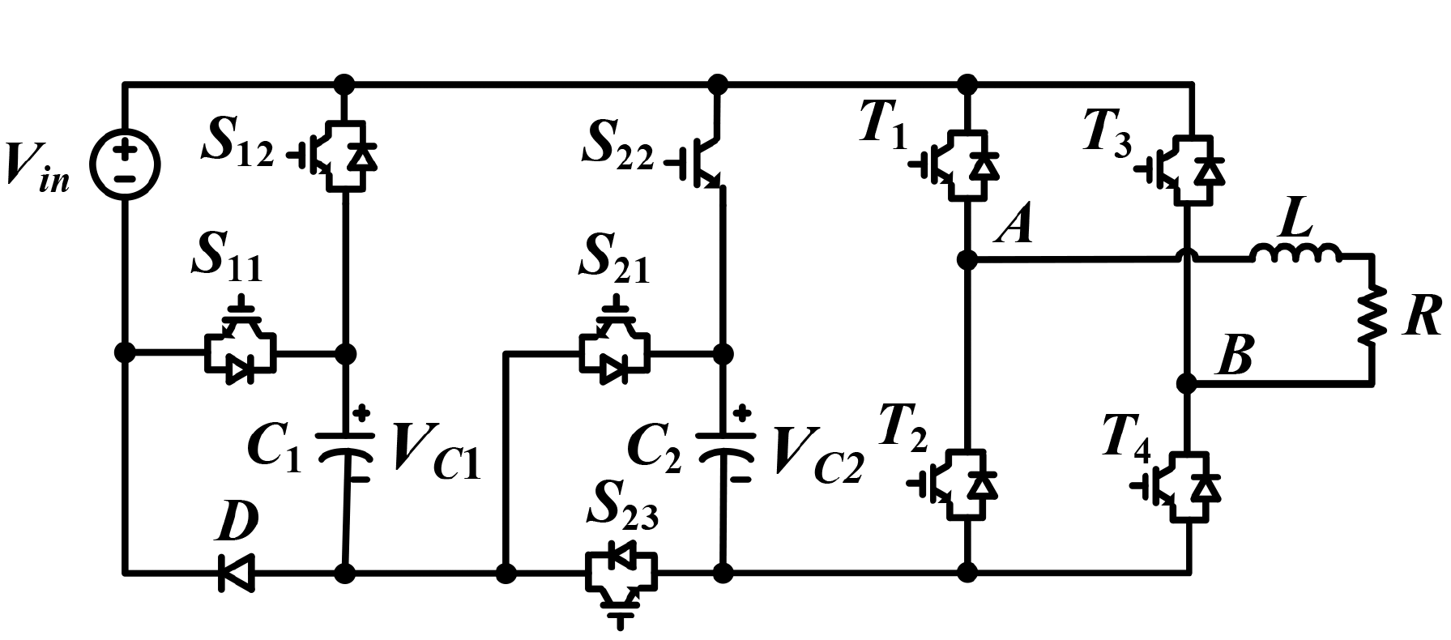
Schematic
SC nine-level inverter topology
The first SC cell :(C₁-D-S₁₁-S₁₂),
The second SC cell :(C₂-S₂₁-S₂₂-S₂₃).

Slide 7
Principle
C₁ is charged while connected in parallel with the input through S₁₂.
It is discharged in series with the input through S₁₁.
C₂ is charged by series combination of the input and C₁ through S₁₁, S₂₂ and S₂₃.
It is discharged in series with C₁ and the input through S₂₁ and S₁₁.
C₁ is thus charged to V_{in} and C₂ is charged to 2V_{in}.

Slide 8
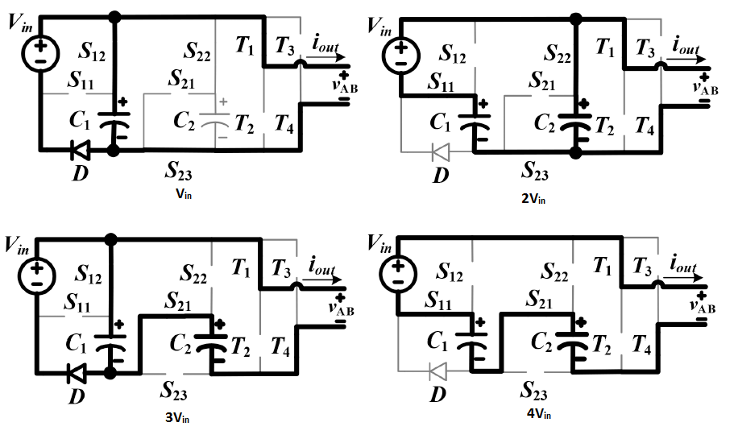
Modes of operation
1V_{in} – Source and C₁ in parallel.
2V_{in} – Source and C₁ in series which is then parallel with C_{2.}
3V_{in} – Source and C₁ in parallel which is then series with C_{2.}
4V_{in} – Source, C₁ and C₂ all in series.

Slide 9
Stages of Work
Literature survey
Mathematical model of SCMI
Design of 350W SCMI
Simulation studies
Prototyping
Performance Analysis
Improvements
Documentation

Slide 10
Schedule
SEMESTER VII
PHASE I
Problem identification(October 2018)
Formulating the Objective of the Project(October 2018)
PHASE II
Literature Survey(November 2018)
Modelling(November 2018)
SEMESTER VIII
PHASE I
Design of Proposed System and simulation study(January 2019)
Prototyping(February 2019)
PHASE II
Performance Analysis and Improvements (March 2019)
Conclusion and Documentation (March 2019)

Slide 11
Current Progress
Problem has been identified and studied.
The system was identified as a viable solution.
Most recent literature regarding the solution was collected and studied.
Principle and working was studied.
Mathematical model of the system prior to simulation studies is being synthesized in the current phase.

Slide 12
Expected Outcome
Consistent solution to the identified problem.
Prototype that can be implemented in large scale.
Simulation Model of the proposed system.
Documentation.

Slide 13
REFERENCE
[1] Bac-Bien Ngo, Minh-Khai Nguyen , Jae-Hong Kim2 and Firuz Zare, “Single-phase multilevel inverter based on switched-capacitor structure”, IET Power Electron, June 2018, ISSN 1755-4535
[2] Barry W Williams, “Principles and Elements of Power Electronics Devices, Drivers, Applications, and Passive Components”, 2006, ISBN 978-0-9553384-0-3
[3] Yuanmao Ye, K. W. E. Cheng, Junfeng Liu and Kai Ding, “A Step-Up Switched-Capacitor Multilevel Inverter With Self-Voltage Balancing”, IEEE Trans. Ind. Electron, Vol. 61, No. 12, December 2014
[4] Bhagyalakshmi P S, Beena M Varghese and Dr. Bos Mathew Jos, “Switched Capacitor Multilevel Inverter With Different Modulation Techniques”, International Conference on Innovations in information Embedded and Communication Systems, 2017

Slide 14
Thank you

